Slide 1

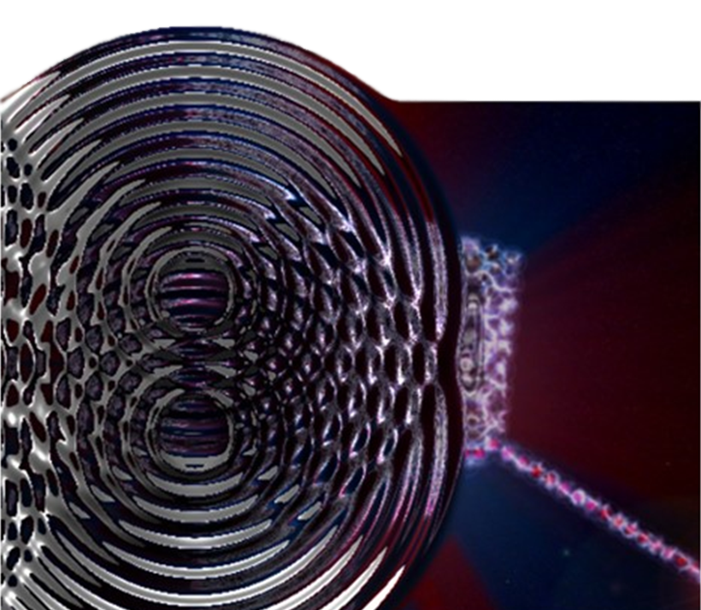
RECURRENT NEURAL NETWORKS
ENGINEERING MACHINE LEARNING
HEALTH TECHNOLOGY

Slide 2
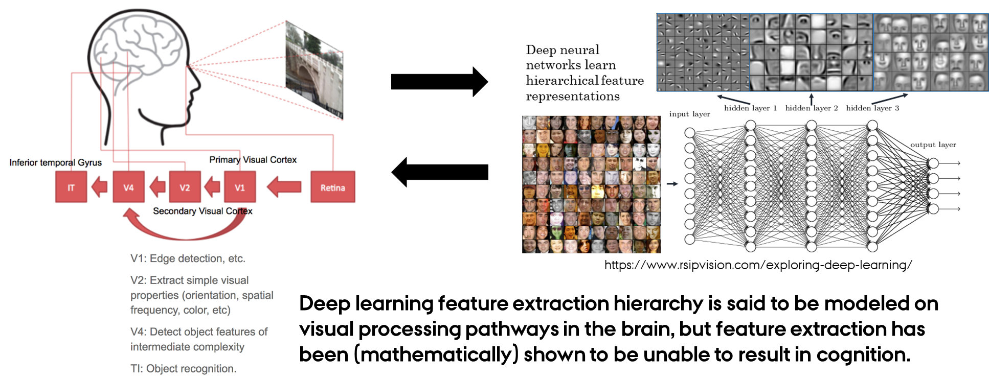
recurrent Receptive fields
DID RECEPTIVE FIELDS REALLY INSPIRE CNN?
Which way is inspiration really flowing?

Slide 3
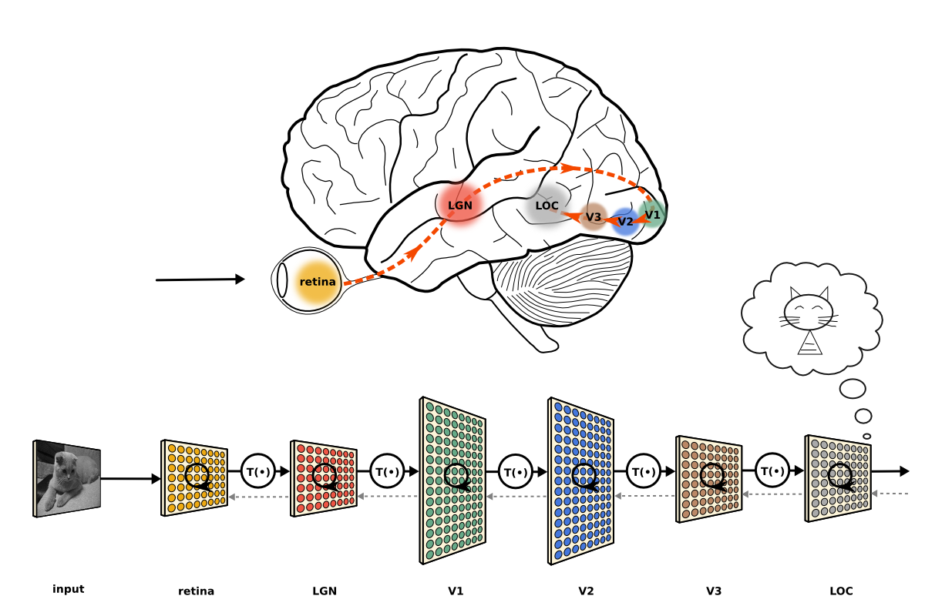
recurrent Receptive fields
DID RECEPTIVE FIELDS REALLY INSPIRE CNN?
Which way is inspiration really flowing?

Slide 4
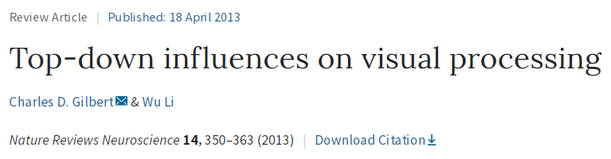
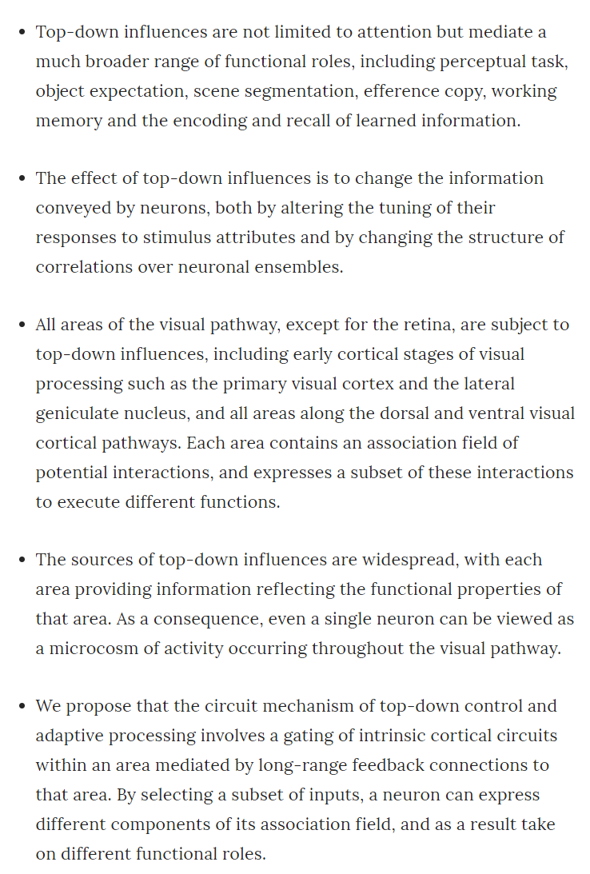
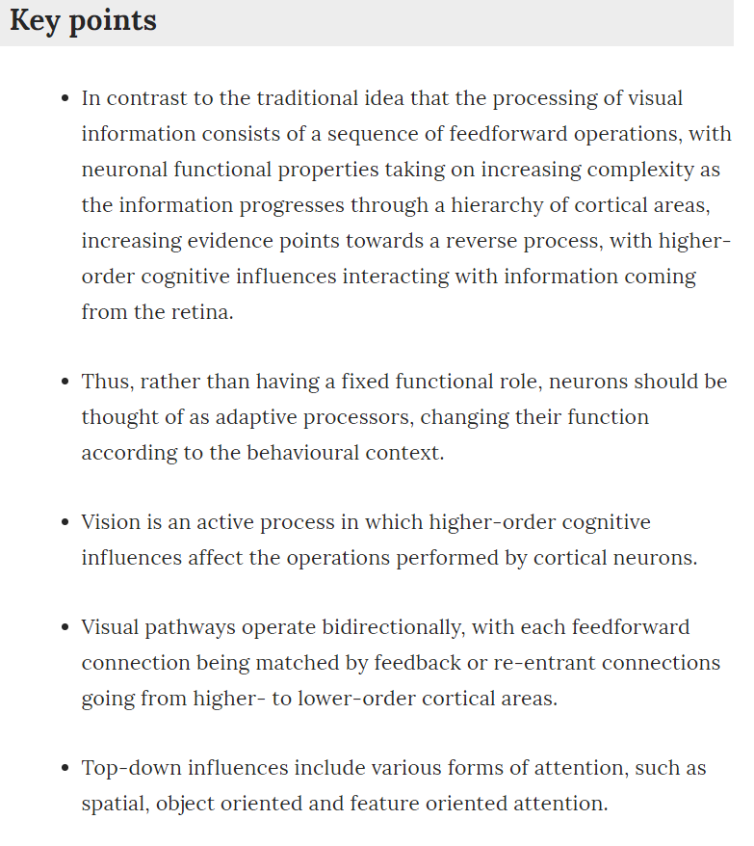
recurrent Receptive fields

Slide 5
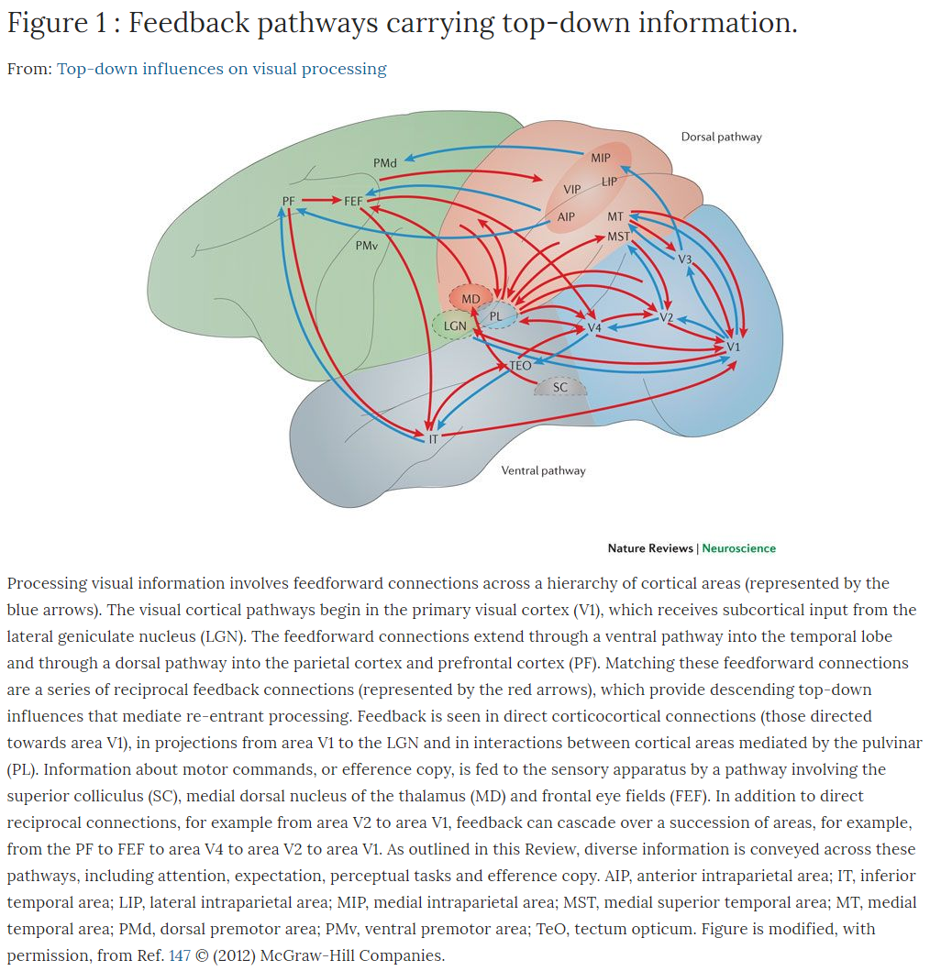
recurrent Receptive fields

Slide 6
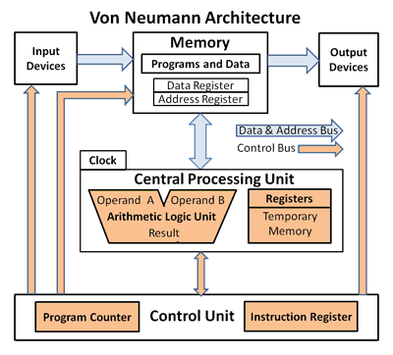
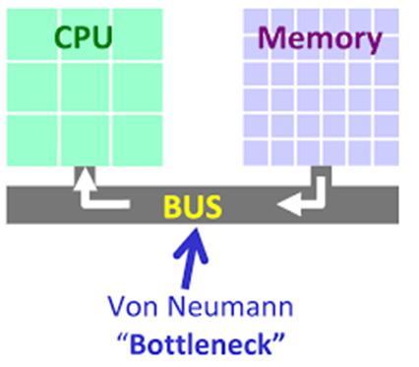
The von neumann bottleneck

Slide 7
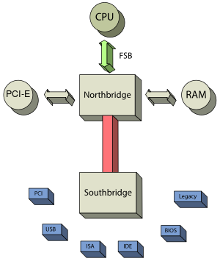
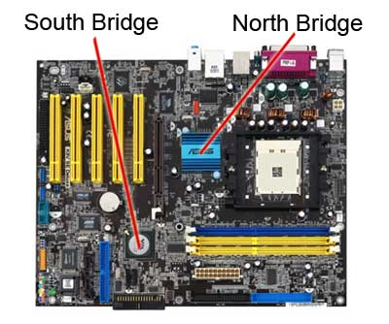
The von neumann bottleneck

Slide 8
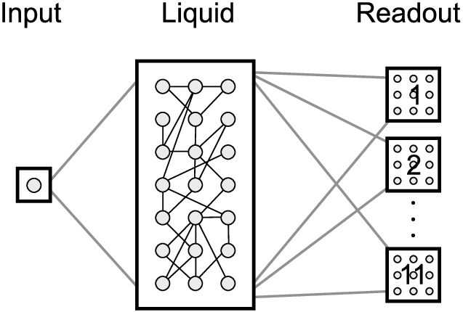
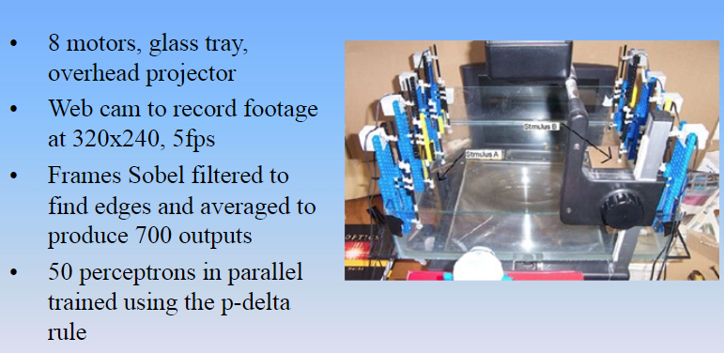
Pattern recognition in a bucket
Processing and memory in the same ‘liquid’ medium, i.e. reservoir computing.
https://slideplayer.com/slide/2267746/

Slide 9

Pattern recognition in a bucket
Processing and memory in the same ‘liquid’ medium, i.e. reservoir computing.

Slide 10
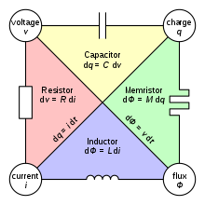
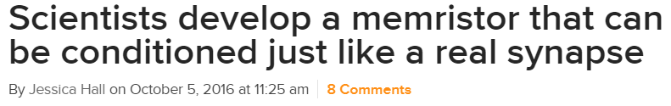
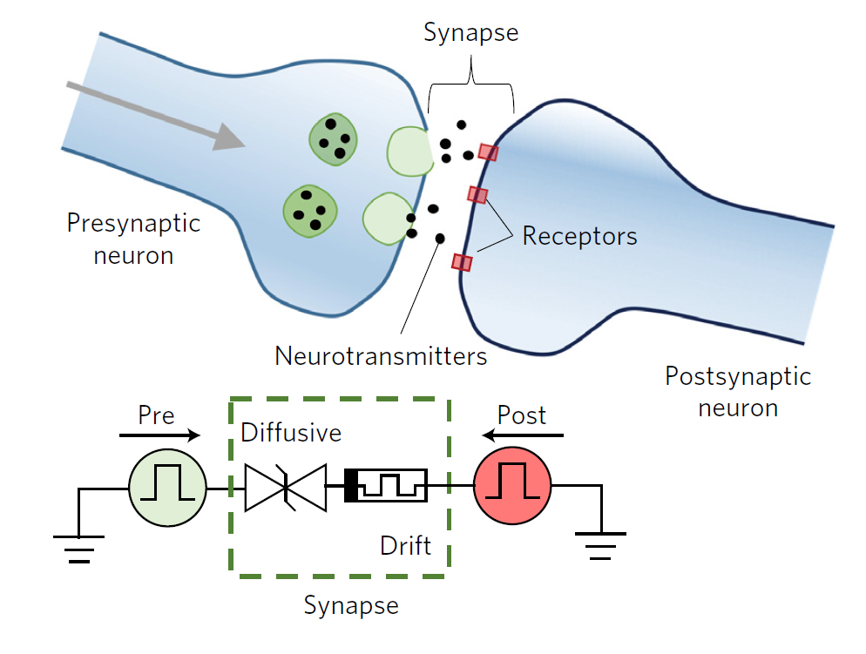
Pattern recognition in a bucket
Reservoir computing with the ‘fourth element’.
A memristor (a portmanteau of memory resistor) is a hypothetical non-linear passive two-terminal electrical component relating electric charge and magnetic flux linkage. WIKIPEDIA

Slide 11
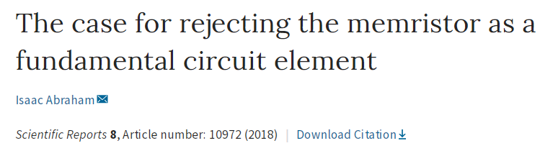
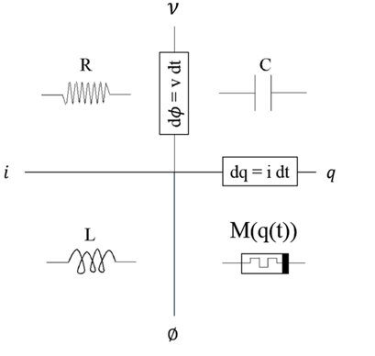
Pattern recognition in a bucket
Reservoir computing with the ‘fourth element’.
“The memory resistor with the moniker memristor was a harmless postulate in 1971. Since 2008 a device that claims to be the memristor is on the prowl, seeking recognition as a fundamental circuit element, sometimes wanting electronics textbooks to be rewritten, always promising remarkable digital, analog and neuromorphic computing possibilities.
We demonstrate with a periodic table of fundamental elements that the 2008 memristor is not the 1971 postulate and neither of them is fundamental. The ideal memristor is an unphysical active device and any physically realizable memristor is a nonlinear composition of resistors with active hysteresis. We also show that there exists only three fundamental passive circuit elements.”

Slide 12
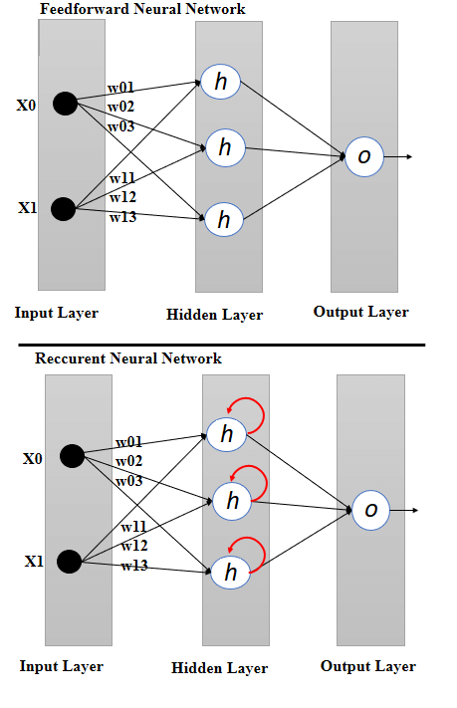
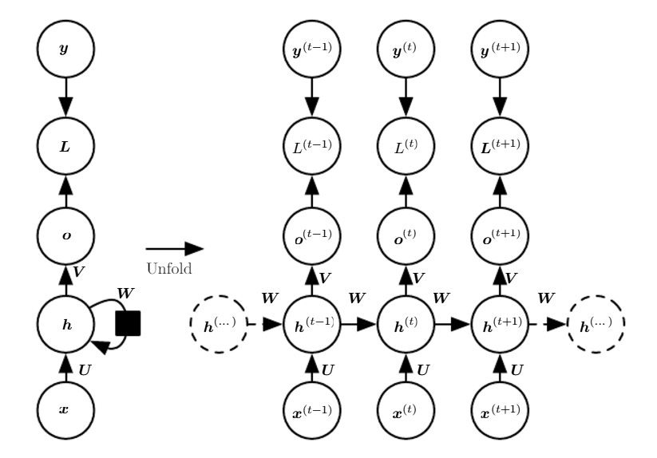
recurrent neural networks
RESERVOIR COMPUTING WITH RECURRENT NEURAL NETWORKS
Training with backpropagation thought time

Slide 13
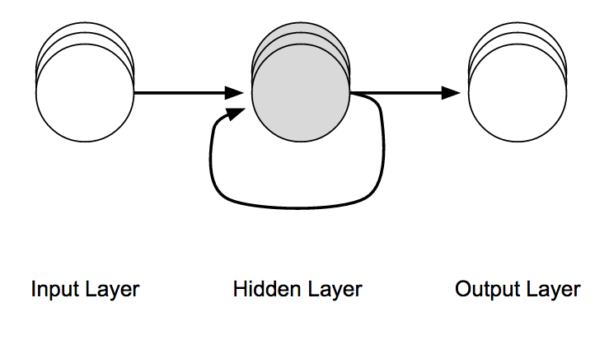
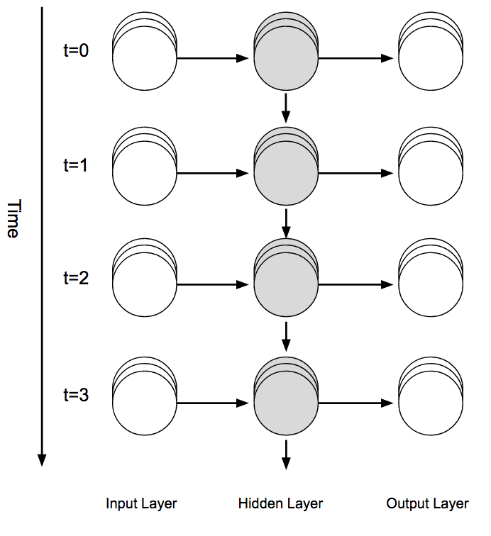
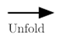
recurrent neural networks
RESERVOIR COMPUTING WITH RECURRENT NEURAL NETWORKS
Training with backpropagation thought time

Slide 14
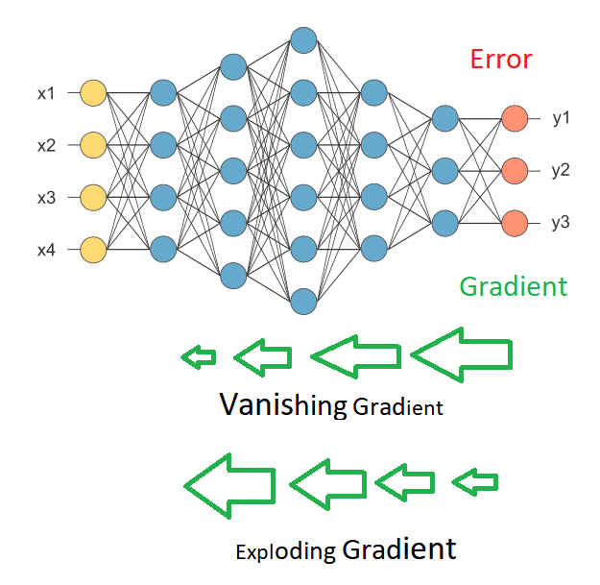
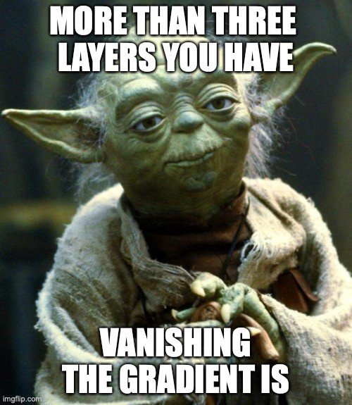
recurrent neural networks
VANISHING AND EXPLODING GRADIENTS
https://medium.com/deep-math-machine-learning-ai/chapter-10-1-deepnlp-lstm-long-short-term-memory-networks-with-math-21477f8e4235

Slide 15
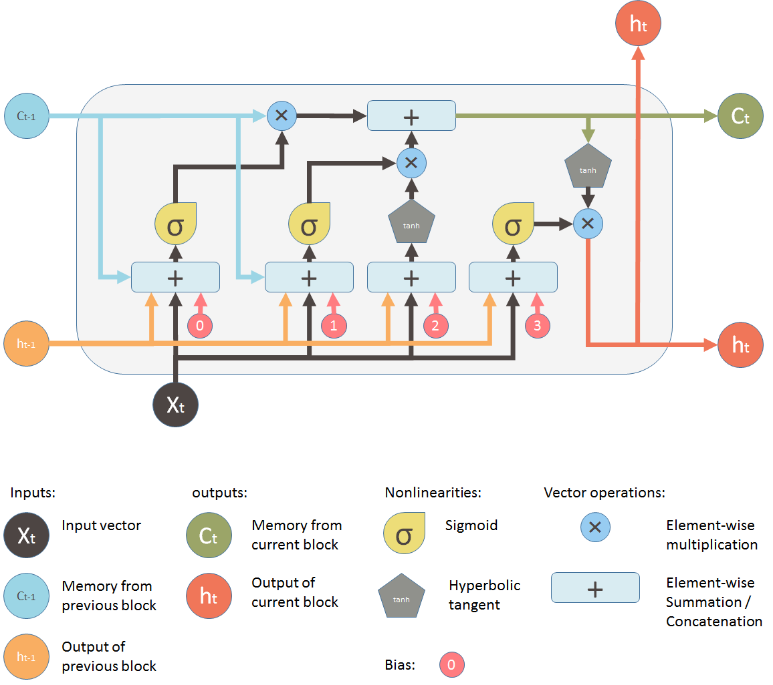
recurrent neural networks
VANISHING AND EXPLODING GRADIENTS – LONG SHORT TERM MEMORY (LSTM)
https://medium.com/mlreview/understanding-lstm-and-its-diagrams-37e2f46f1714

Slide 16
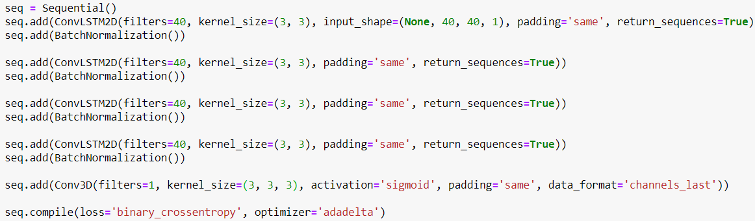
recurrent neural networks
RECURRENT CONVOLUTIONAL LSTM NETWORK IN KERAS
https://srirangatarun.wordpress.com/2018/07/09/video-frame-prediction-with-keras/

Slide 17

recurrent neural networks
RECURRENT CONVOLUTIONAL NETWORK IN KERAS
Train on many random initializations and trajectories – 15 frames each.
Test: Use first 7 (unseen) frames as ‘stimulus’, predict the rest.
https://srirangatarun.wordpress.com/2018/07/09/video-frame-prediction-with-keras/

Slide 18
recurrent neural networks
RECURRENT CONVOLUTIONAL NETWORK IN KERAS
https://srirangatarun.wordpress.com/2018/07/09/video-frame-prediction-with-keras/

Slide 19
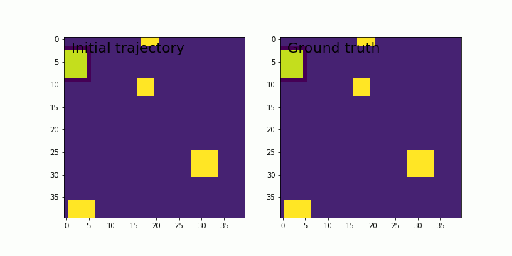
recurrent neural networks
RECURRENT CONVOLUTIONAL NETWORK IN KERAS
https://srirangatarun.wordpress.com/2018/07/09/video-frame-prediction-with-keras/

